Slide 1


DEPARTMENT OF ELECTRONICS AND COMMUNICATION ENGINEERING
18ECP105L-MINOR PROJECT- III
ZEROTH REVIEW
SUSTAINABLE URBAN FARMING USING HYDROPONICS
YEAR/SEMESTER-III/V BATCH NUMBER: 7
DATE:06.09.2024
GUIDED BY :
D.PUSHPALATHA ,AP/ECE

Slide 2
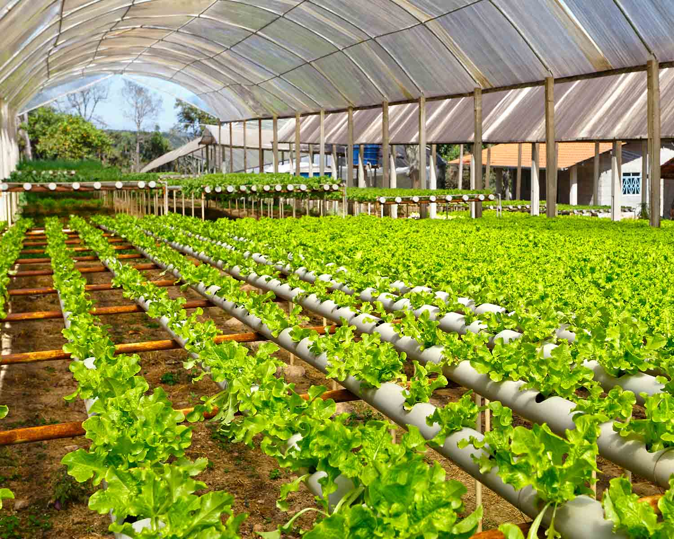
TEAM MEMBERS
M.ARTHI (927622BEC016)
S.DEEPIKA (927622BEC029)
R.DHARSHNA (927622BEC040)
D.DIVYADHARSHINI (927622BEC045)

Slide 3
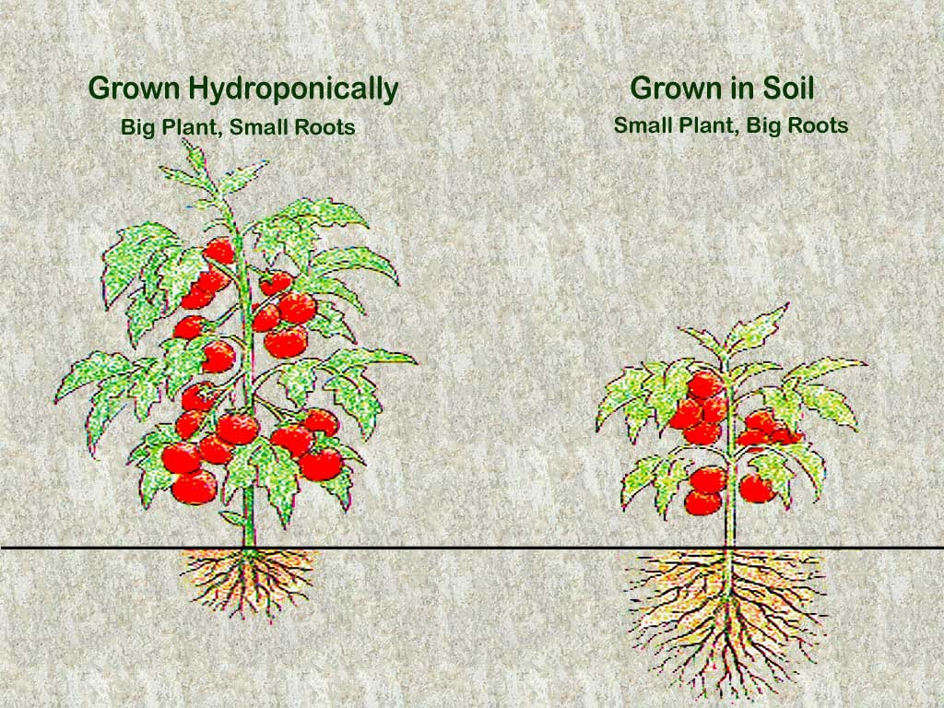
PROBLEM STATEMENT
By 2050, we will need to increase food production by about 70% in order to meet the caloric needs of a global population of 9.8 billion people.
68% of whom are projected to live in urban areas.
38% of earth’s non-frozen land is used for growing food.
This percentage will continue to rise: by 2050, 593 million hectares of land will need to be transformed into agricultural land

Slide 4
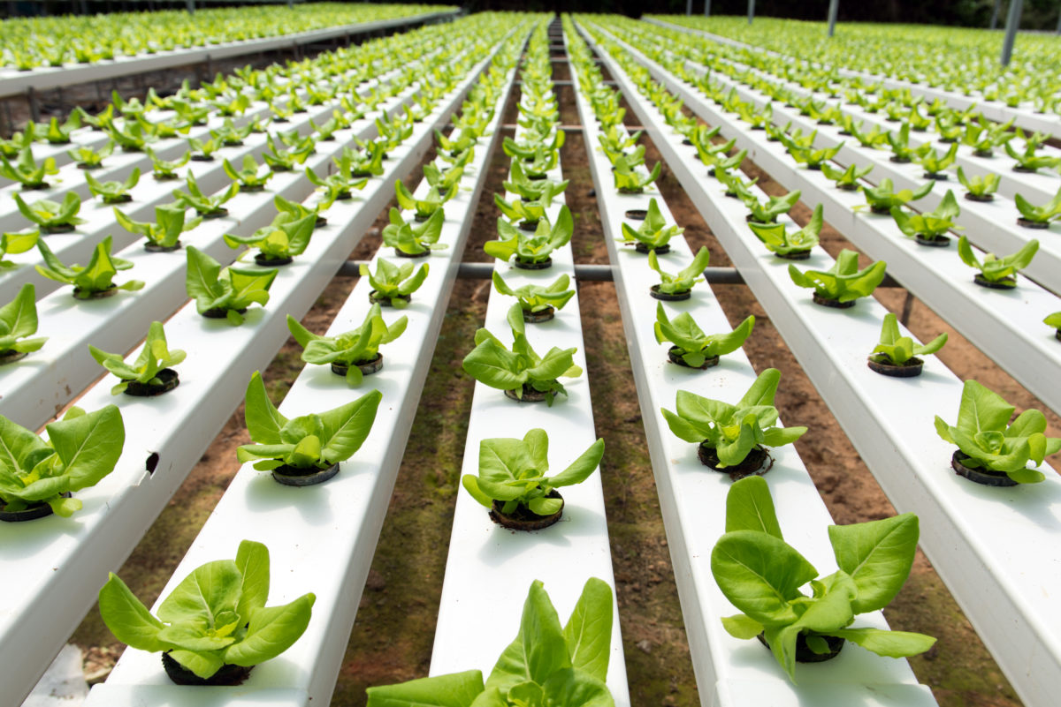
OBJECTIVE
The main objective of this project is to create an automated hydroponics system that uses the Blink app to monitor and control various aspects of plant growth, such as nutrient levels, light, and temperature, in real-time. This aims to optimize plant growth and resource use in a sustainable and efficient manner.This project also uses the solar panels to overcome the energy sufficiency.

Slide 5
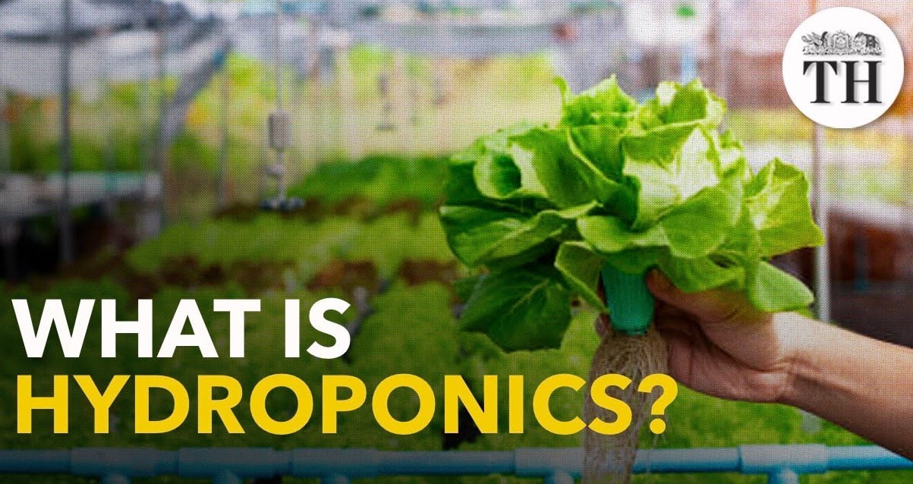
ABSTRACT
This project aims to develop an automated hydroponics system using IoT technology integrated with the Blink app and powered by solar panels to monitor and control essential factors for plant growth, such as nutrient levels, light, and temperature, in real-time. The system employs sensors to collect data, allowing users to remotely adjust and optimize the growing environment through the app. By using solar energy to power the system, it ensures energy efficiency and sustainability. Additionally, the automation of these factors enhances plant growth efficiency, conserves water and energy, and promotes sustainable urban farming. This innovative approach allows for year-round crop production while minimizing resource use, manual intervention, and carbon footprint.

Slide 6
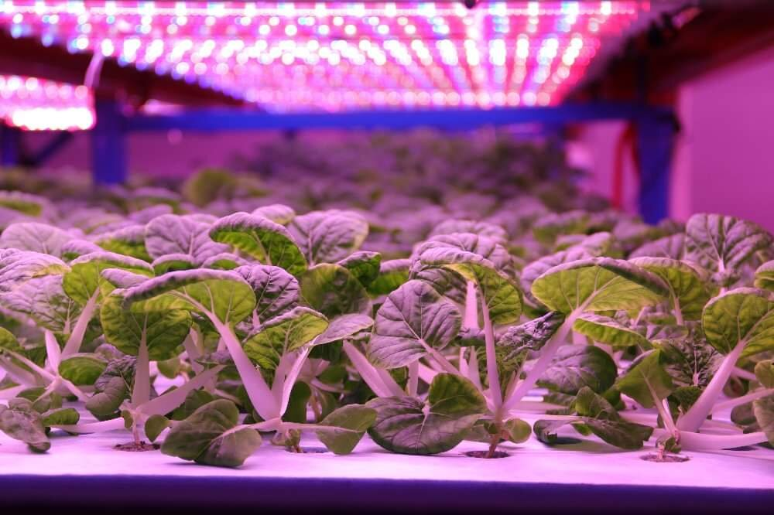
ADVANTAGES
Global food security
Hydroponics can help achieve sustainable food security by producing high-quality food in all regions of the world.
Resource conservation
Hydroponics uses fewer resources than conventional farming.
Water conservation
Hydroponics allows you to precisely deliver the exact amount of water each plant needs, without wasting any.
Biodiversity
Urban farms can increase biodiversity in cities by providing habitats for various species.

Slide 7
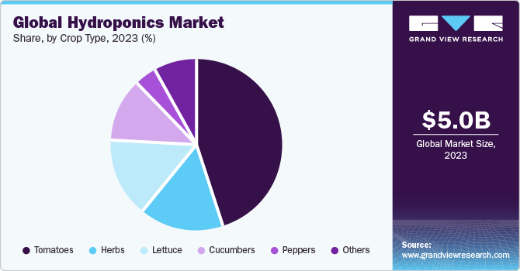
LITERATURE SURVEY
M. Butturini et al.Chapter 4 - vertical farming in Europe: Present status and outlookL. Casey et al.Comparative environmental footprints of lettuce supplied by hydroponic controlled-environment agriculture and field-based supply chainsJ. Clean. Prod.(2022)
“Supachai Puengsungwan”, “Internet of Things (IoT) based hydroponic lettuce farming with solar panels”, - IEEE, 2019.
“Tharindu Madushan Bandara”, “Smart farm and monitoring system for measuring the Environmental condition using wireless sensor network-IOT Technology in farming”, - IEEE, 2020.

Slide 8
REFERENCE
M. Al-ChalabiVertical farming: skyscraper sustainability?Sustain. Cities Soc.(2015)J.C. Aurich et al.Life cycle oriented design of technical product-service systemsJ. Clean. Prod.(2006)
T. Blom et al.The embodied carbon emissions of lettuce production in vertical farming, greenhouse horticulture, and open-field farming in the NetherlandsJ. Clean. Prod.(2022)

Slide 9


